Slide 1
BIT BY BIT
Team Members:- Tanuj Joshi.
Vaishnavi Vengurlekar.
Riddhi Gandhi.
Siddhesh Parkhe.
Shreya Nogja.

Slide 2
What we have tried to build ?
Content
What problem are we trying to solve ?
Why our application should be considered ?
Additional Features.

Slide 3
In this particular hackathon we have tried building a Options Chain webpage which is similar to other stocks webpages. This is a dynamic page which fetches the real time data from a time series data and displays that data on a live web page. It further performs various operations such as calculating IV, CHNG, CHNG IN OI and displays that data as well. This page keep changing in few seconds to display the updating data.
What we have tried to build?

Slide 4
What problem are we trying to solve?
The NSE Website has a refresh button where we manually have to press the refresh button so we have removed that refresh button and data is being refreshed within few second as the NSE was having delay of 3 min to update data is also decreased to few second.

Slide 5
Why our application should be considered ?
Our application should be considered because it offers real-time processing of market data, accurate calculation of implied volatility, and a user-friendly interface for the options chain.. By choosing our application, the judges will select a comprehensive, reliable, and user-centric options chain tool that empowers traders and investors with timely and valuable information.

Slide 6
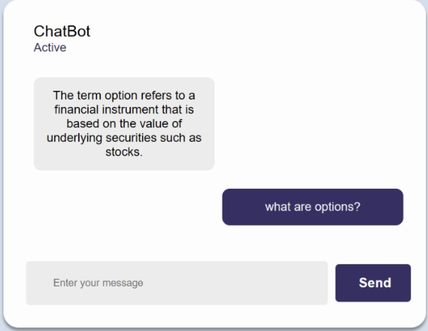
Additional Features
Chat Bot
Chatbot-created chatbot which acts as support,you can ask questions like what are options and FAQ in react.js but could not interate due to time constarints.
Which support some Queries.
Little Indian Decode

Slide 7
Thank You!!

